Slide 1
MARKETING DATA ANALYSIS AND INSIGHTS

Slide 2
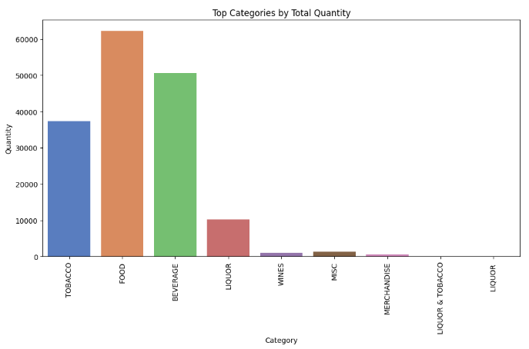
EXPLORATORY DATA ANALYSIS (EDA)
Top 10 categories sold: Food is the highest, followed by Beverage, and then Tobacco

Slide 3
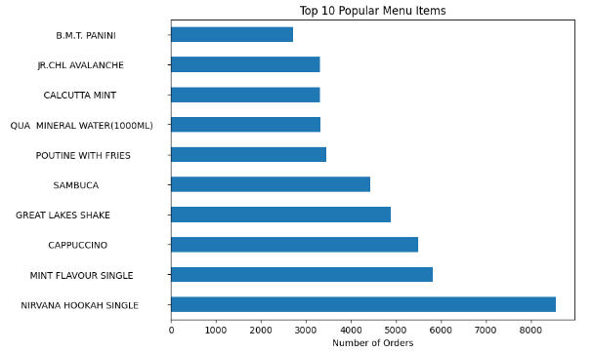
EDA (CONTD.)
The graph below shows us the top 10 most popular menu items

Slide 4
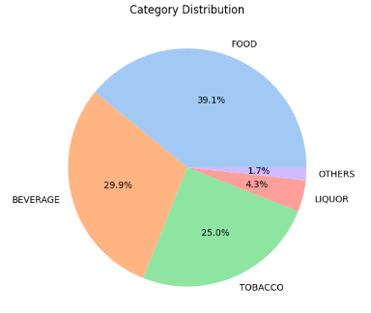
EDA (CONTD.)
Let us view the category distribution. It is quite clear that food tops all other categories, followed by beverage and tobacco

Slide 5
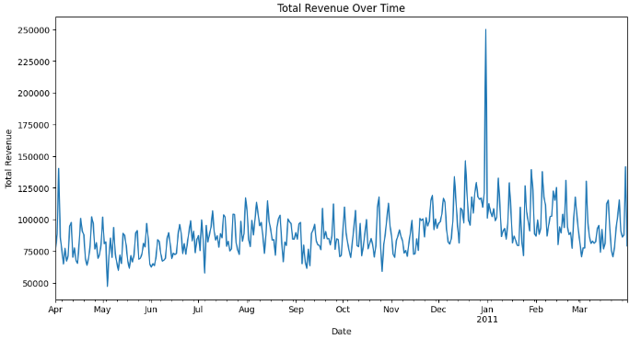
EDA (CONTD.)
Revenue made per month (the only month with unusually high revenue is Jan 2011

Slide 6
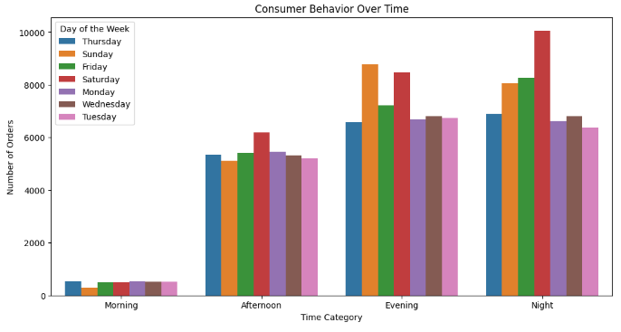
EDA (CONTD.)
Customer density visualized at 4 quarters of every day. It is clear that at evening and night, there are highest number of customers the whole week, while morning has the least number of customers.

Slide 7
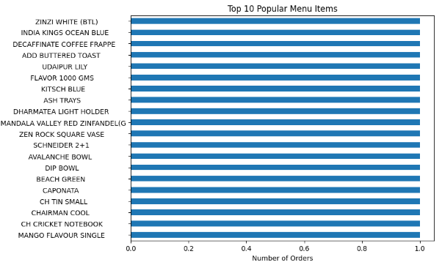
EDA (CONTD.)
20 least popular menu items which we can remove from the menu

Slide 8
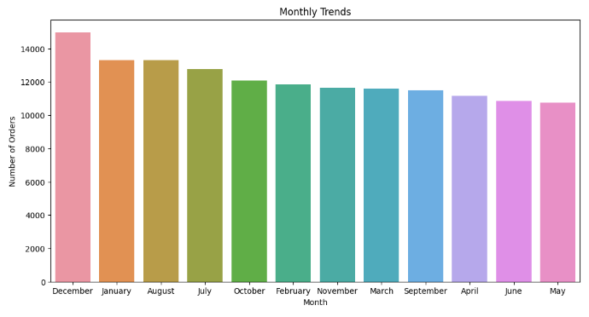
EDA (CONTD.)
Order density per month. We can see that December, January and August have the highest number of orders

Slide 9
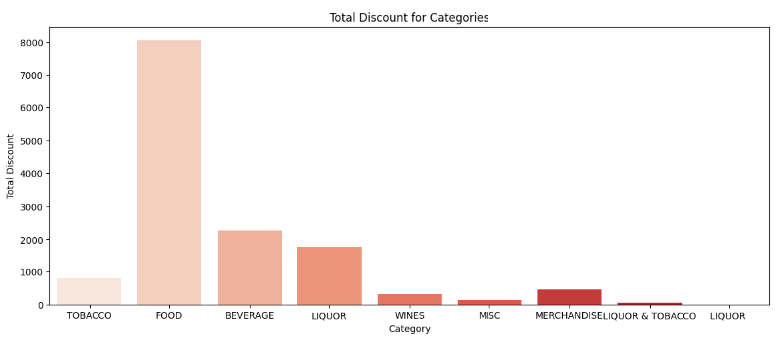
EDA (CONTD.)
Total discount provided for each category. We can see that again food has the highest amount of discount provided, but we should also provide discount for beverage since it is quite popular.

Slide 10
MARKET BASED ANALYSIS AND ASSOCIATION RULES
Market basket analysis is a data mining technique that explores relationships between products frequently purchased together. It identifies patterns in consumer behavior by examining transactional data, helping businesses make informed decisions related to product placement, cross-selling, and promotional strategies. In a cafe setting, it can unveil which menu items are commonly ordered together, providing opportunities for bundling or targeted promotions.
Association rules from market basket analysis offer actionable insights. They comprise antecedents (items in a transaction) and consequents (likely purchases). Metrics include:
Support: Frequency of rule occurrence in the dataset, indicating the proportion of transactions with both antecedents and consequents.
Confidence: Likelihood that antecedents lead to consequents, with high confidence suggesting strong item association.
Lift: Ratio of observed to expected confidence, indicating how much more likely consequents are to be bought when antecedents are present.

Slide 11
IMPORTANCE OF ASSOCIATION RULES IN THIS PROJECT
In this project, market basket analysis and association rules are essential for understanding customer preferences and optimizing the cafe's offerings. Identifying popular item combinations allows the cafe to create targeted promotions or bundle items for increased sales. For instance, if certain beverages and snacks are commonly purchased together, the cafe could create combo deals or recommend these pairings to customers, enhancing their experience and potentially boosting revenue. Confidence, lift, and support values guide decision-making by quantifying the strength and significance of these associations.

Slide 12
ANALYSIS AND RECOMMENDATIONS
Positive Food Combos:
Offer combo deal bundling beverage + food item (strong co-occurrence)
Analysis shows beverages and food items frequently purchased together (lift > 1)
Specific combo examples: sandwich + soft drink, fries + milkshake
Consider triple combo with tobacco + beverage + food (may appeal to some segments)
Combination occurs reasonably often together in data
Specific examples: cigarettes + soda + burger, cigar + beer + wings
Offer simple combo with food + tobacco item (frequent co-purchase)
Food and tobacco categories show strong co-purchase patterns
Examples: fries + cigarettes, nachos + chewing tobacco
Offer combo with beverage + tobacco (also frequently purchased together)
Beverage and tobacco also have positive association
Combo examples: coffee + cigarettes, soda + e-cigarette

Slide 13
ANALYSIS AND RECOMMENDATIONS (CONTD.)
Avoid Bundling:
Tobacco with food + beverage bundle
Analysis shows lower lift for tobacco with food+beverage bundle
Keep tobacco combos separate rather than adding to food+beverage
Tobacco + dairy items
Specific item associations show low affinity between tobacco and dairy
Avoid combos like cigarettes + milkshake
Alcohol + breakfast items
Alcoholic drinks and breakfast foods not commonly co-purchased
Avoid bundles like beer + pancakes

Slide 14
ANALYSIS AND RECOMMENDATIONS (CONTD.)
Some "buy one get one free" style promotional offers based on the association rules:
"Buy 1 Food, Get 1 Beverage Free"
Could offer BOGO deal for frequently bundled food + beverage
Example: Buy sandwich, get soft drink free
"Buy 2 Food Items, Get 1 Tobacco Product Free"
Promotes tobacco + food co-purchase
Example: Buy fries + burger, get cigarettes free
"Buy 2 Beverages, Get 1 Tobacco 50% Off"
Incentivizes beverage + tobacco association
Example: Buy 2 sodas, get 50% off chewing tobacco
"Buy Food+Beverage+Tobacco, Get 30% Off Bundle"
Steeper discount to promote triple category combo
Example: 30% off basket with burger + soda + cigarettes
The key is to structure BOGO and bundle discounts around the key associated item pairings to incentivize co-purchase. Discounts can be adjusted based on profit margins.

Slide 15
THANK YOU!

